Slide 1
Johnny Cade
Outsiders
By,
Taylor m
Camden in Spirt m
Darin m
Notes:
We read

Slide 2
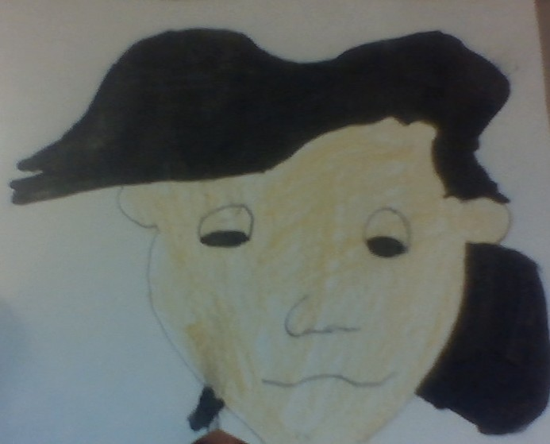
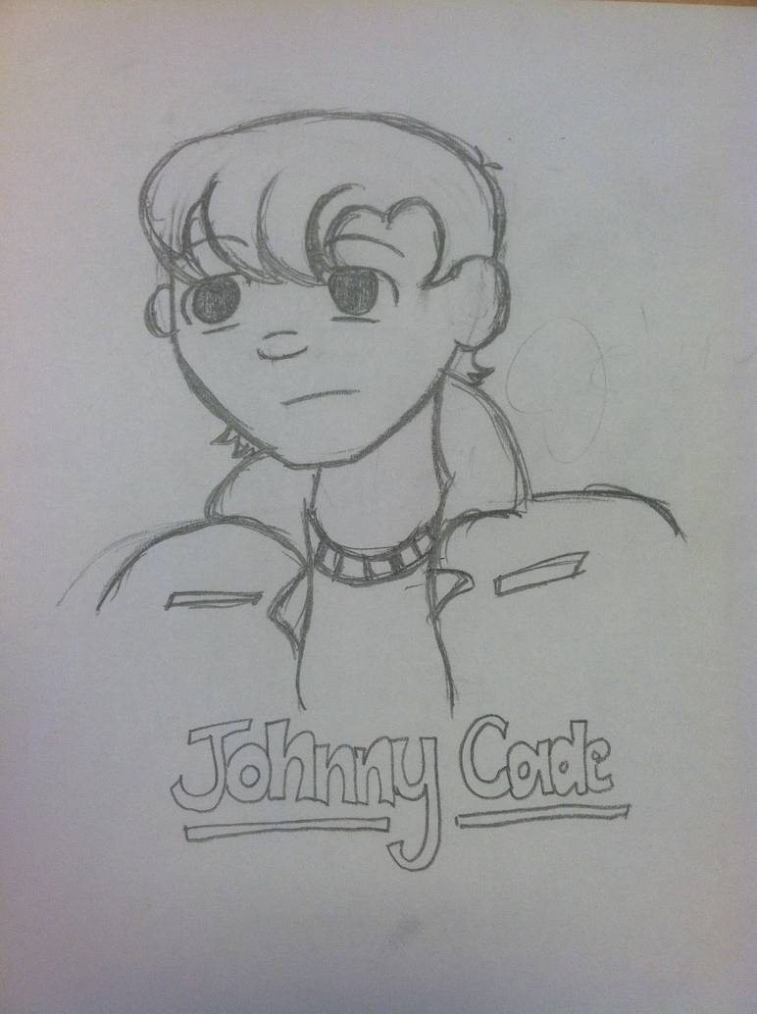
Notes:
Daryn reads

Slide 3
So Johnny Cade did not have a good childhood. His mom never loved him and would never even talk to him, unless it was to yell at him, Sometimes you could hear the argument from down the street. His dad would always beat on him or yell at him. He probably would have run away, and definitely never would have known love and affection was like if it weren't for the gang. He is also very very shy and doesn't like to talk to people even the gang.
Notes:
Dary reads

Slide 4
His Physical Traits
He has big jet black eyes and hair
Darker face
He is young compared to the people in the gang
Shaggy bangs to the side
Not strong
Very shy
Notes:
I read

Slide 5
His mental traits
He was beat on as a kid
Mom never loved him
He was a gang pet
Everyone's brother
Shy around people
Never knew what love and affection was before the gang
Youngest in the gang
Notes:
I read

Slide 6
The End

